Slide 1
Character Traits

Slide 2
Do you support me or not?
Raised in Hawaii
Smokes
Father of 2
Coach of daughter’s team
Graduate of Harvard
Lawyer
Order the death of a man
Said man was Osama Bin Laden
Democrat

Slide 3
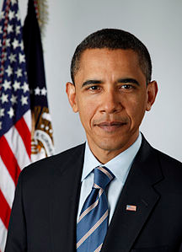
President Obama

Slide 4
Do you support me or not?
High school drop out
Billionaire
Refuses to give money to charity
Thief
Has helped more disabled people than any others in the world
Changed the way that we interact with technology
Has made some of the most sought after devices in the world

Slide 5
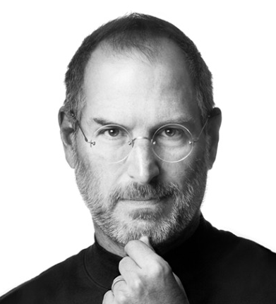
Steve Jobs

Slide 6
Do you support me or not?
Best selling artist in 2000/Emmy awarded
Drug addict
Founder of an inner-city charity
Accused of being abusive to women
Accused of being homophobic
Publically supported gay & women’s rights
FBI investigated him as a threat to the president
Best selling rap artist of all time

Slide 7
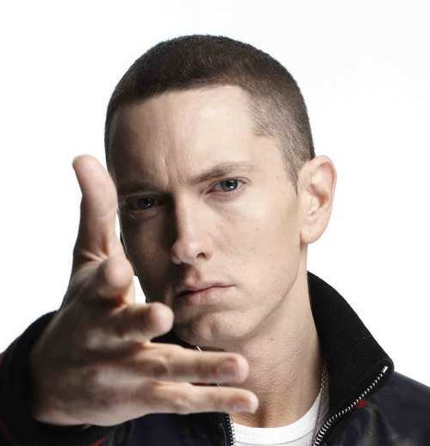
Eminem

Slide 8
Do you support me or not?
Raised in Florida
Raised in a single family by mother
Kicked out of home and sent to foster care in Roswell, Georgia
Drug Dealer (as was his absent father)
Host of his own Spanish-language program on the cable channel Mun2 titled La Esquina
Singer, song-writer, record producer…
Teen Choice, Billboard, and ALMA, award winner

Slide 9
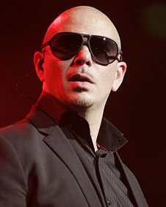
Pitbull

